Slide 1
Anna --------------
INDIVIDUAL PEACE PROJECT

Slide 2
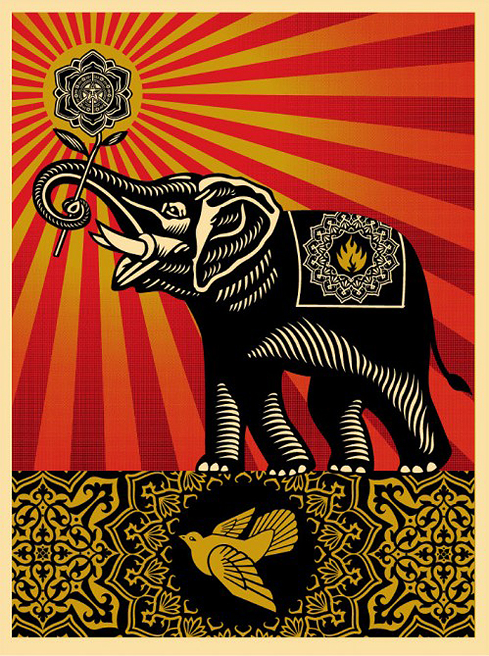
This 2008 piece of graphic art inspired me through the unique
representation of peace. While the dove is present which is
known to represent peace, there is also an elephant. Elephants
are known to be dangerous at times but in this situation, holding a flower, it is peaceful. The flower is also a mandala, a spiritual and religious symbol often used in artworks regarding peace.
“Peace” by Shepard Fairey

Slide 3
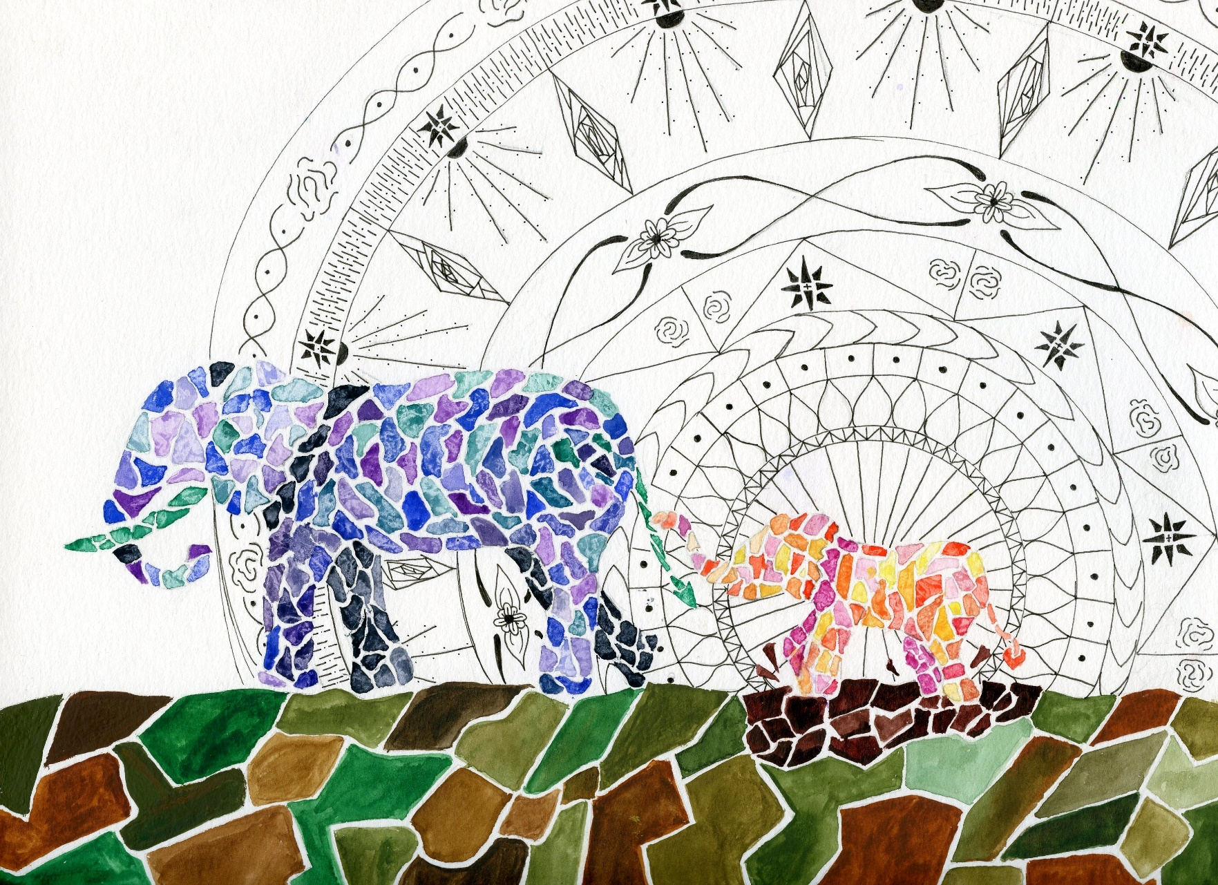
“NOONTIME WALK” BY ANNA ------------

Slide 4
“NOONTIME WALK”
I used water color to paint the two elephants and the ground in a geometric pattern. Behind the smaller, younger elephant is a mandala drawn in fine tip black pen. I wanted to convey that there are multiple types of peace. There is the older, mature peace represented in the cooler darker colors of the mother elephant that comes with age and experience. There is also the unrestrained peace of the elephant splashing in the mud shown through bright colors. This peace comes from the knowledge that, just as the baby as his trunk wrapped around his mother’s tail, we all have something we can rely on. The mandala shows that peace starts even at an early age as it bursts out from the baby elephant like rays from the sun.

Slide 5
THE MESSAGE OF PEACE
Both Fairey’s and my own elephants convey peace
alongside a mandala. Fairey’s shows peace as the
elephant takes a dominant stance, ready to stand
firm in the name of peace. My elephants, however,
walk along knowing they are in a time of peace.
Both show that peace is not just freedom from war,
but a state of mind or a desire to fulfill.

