Slide 1
“Peace In Our Hands” Glenda Hecksher
This painting is located in Morelos. I like how from one angle the sculpture is just interlocked hands, but from another is a sign of peace. I saw it that hands can do anything, but in the right circumstances be peaceful.

Slide 2
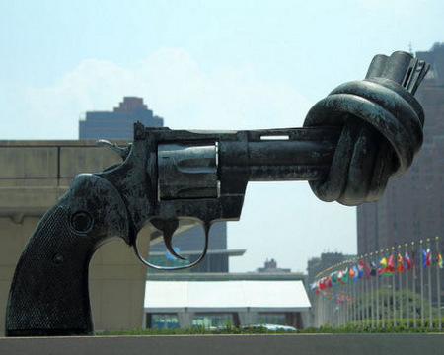
“Knotted Gun” by Carl Reutersward (outside of the United Nations Headquarters)
I like this sculpture because it shows that to have peace, you must first deal with an existing problem. The knot addresses tying off an already present problem.

Slide 3
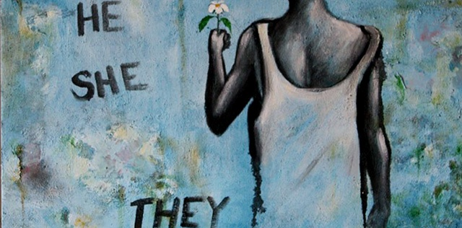
“Justice Under Construction” Diverze Youth Art Platfrom
This is part of an art display located in San Diego, California created to celebrate Myanmar artists. These artists document their country’s journey from military rule to democracy peacefully through art.
I personally like this multimedia piece of art because it combines political aspects and personal issues of gender stereotypes into art. It empowers both men and women to do whatever they want.

Slide 4
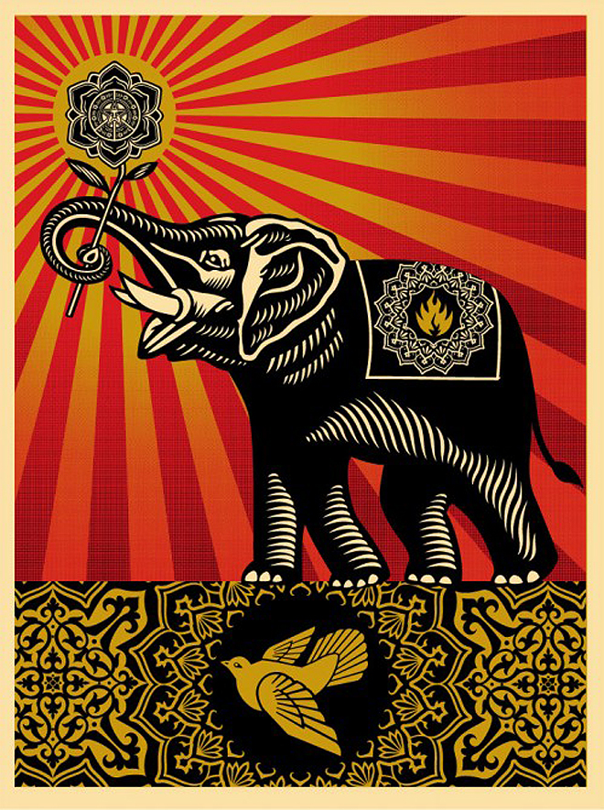
“Peace” by Shepard Fairey
This street artist is Los Angeles, California. All the colors are visually pleasing to the eye even though they contrast each other and may seem vivid. I like how he incorporates the usual signs of peace with a dove but also includes the elephant as well.

Slide 5
Hidden Peace
Clasped together by a thumb;
Intertwined.
Not to be undone,
By the test of time.
Though they might seem like just hands,
If you take another view,
Another stand.
A dove will rise anew.

Slide 6
Sources
1) http://1peace1peacenews.blogspot.com/2012/10/peace-sculptures-become-4-in-world-make.html
2) http://cpnn-world.org/cgi-bin/read/articlepage.cgi?ViewArticle=353
3)http://www.sandiego.edu/peacestudies/institutes/ipj/programs/art-of-peace/
4) https://www.wired.com/2010/08/shepard-fairey-auction/

