Slide 1
By: Ashton
Independent Peace Project

Slide 2
Inspiration
House of Love and Diversity
Sandra Silberzweig
The painting demonstrates that harmony can be found, even when it may seem like there is chaos. The painting fits aspects of life and nature together like a puzzle to show peace. Even though each “piece of the puzzle” is diverse, it all fits perfectly together.

Slide 3
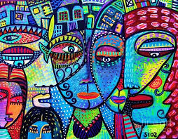
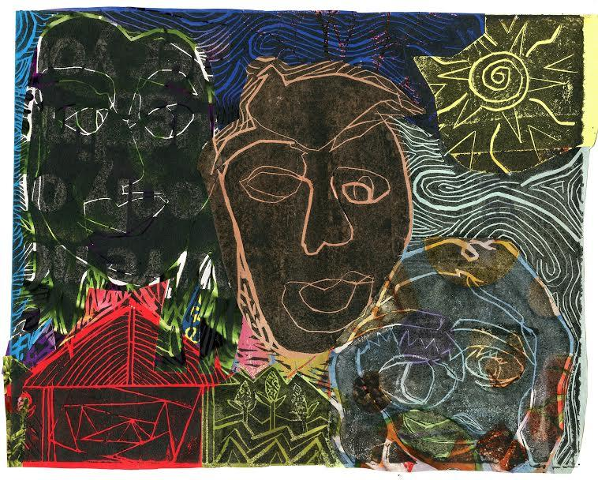
Message of Peace
House of Love and Diversity and A House of Many Faces demonstrate peace in the same way. Each piece of art fits many aspects of nature and life into a puzzle. The art at first may seem as if certain aspects should be separate, such as the fish out of the water on the left and the shared hair on the right. However, the message that both of these pieces is sending is that all aspects of nature are harmonious and fit together to create peace.

Slide 4
Printmaking
Lino Printing Process
Draw with pencil the original design.
Use carbon paper to transfer design onto the piece of lino.
Carve on the lines of the design.
The places that are carved will be negative spaces on the print and the places that have not been carved will show up with ink.
Roll out the printmaking ink until it is tacky.
Roll the ink over the carved lino.
Place a solid piece of paper onto the lino.
Press hard on the print until the ink has adhered to the piece.
Slowly remove the print from the lino block.

Slide 5
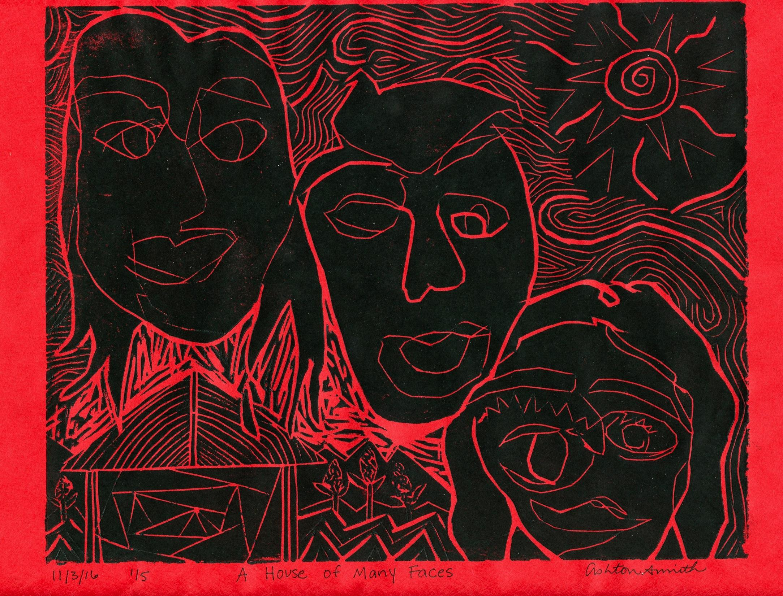
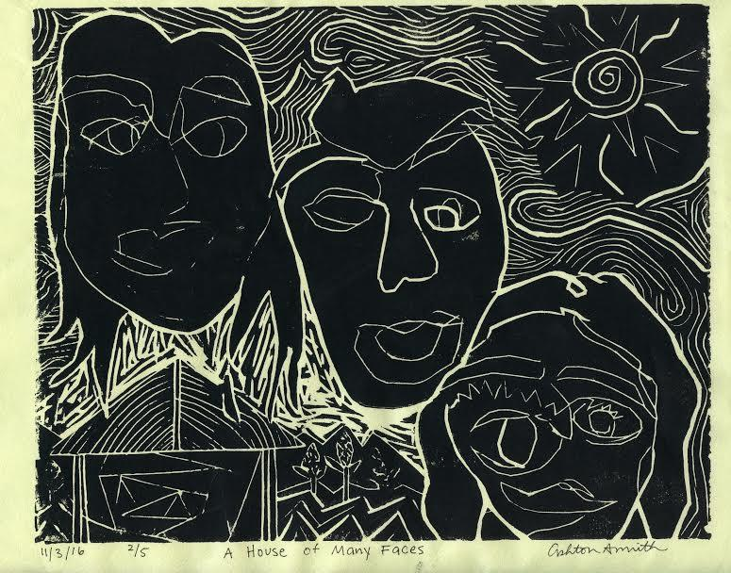
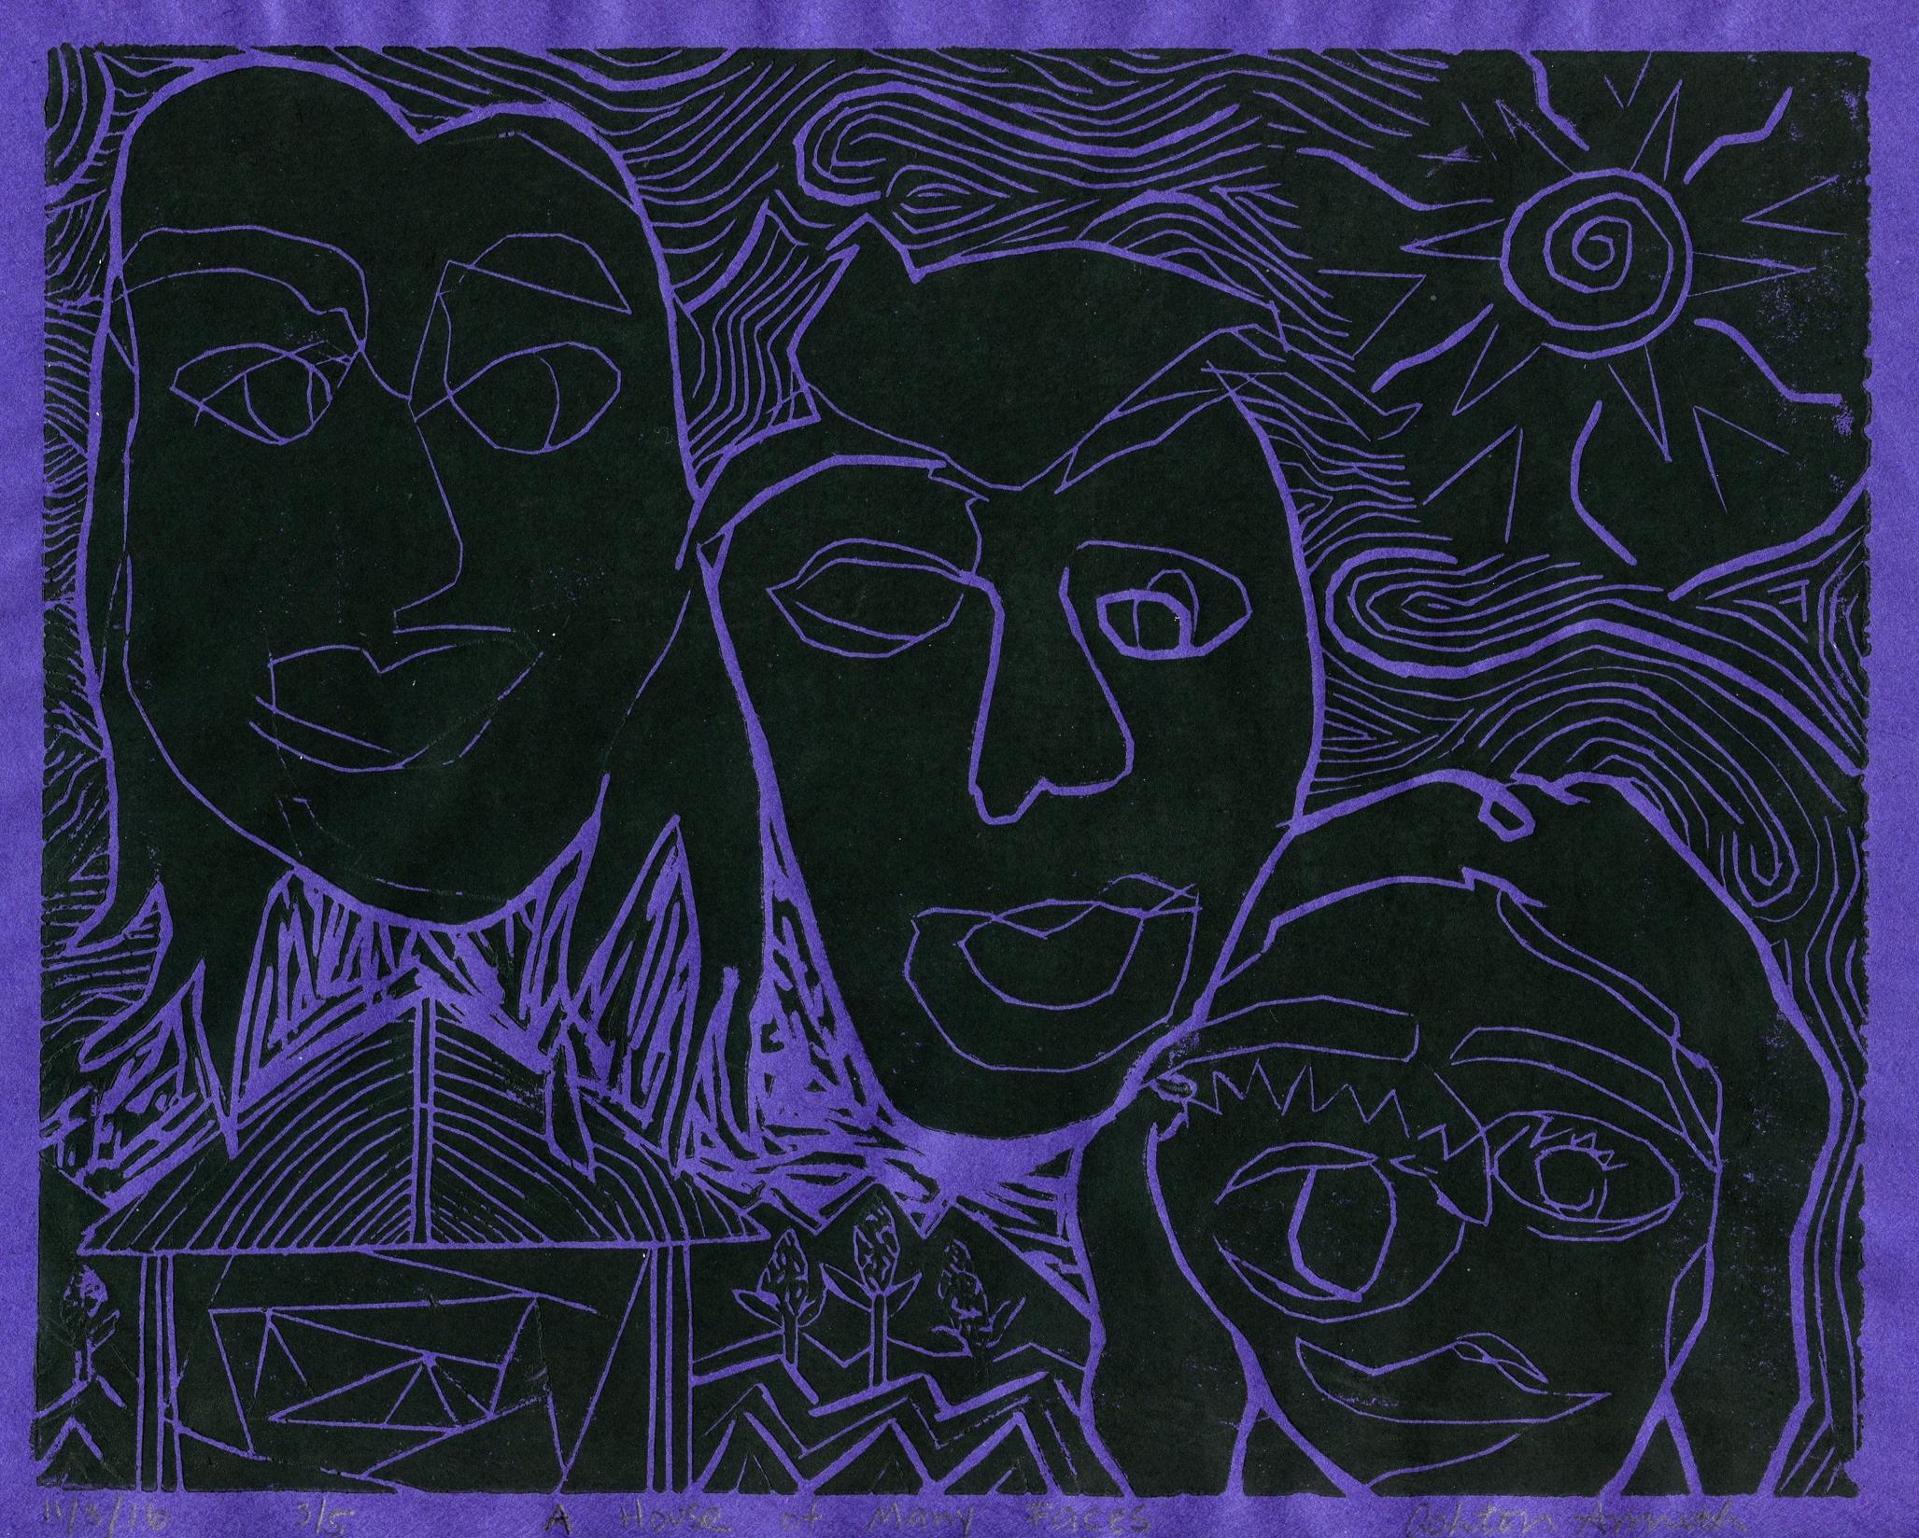
Prints
Notes:
5

Slide 6
Chine-Colle
Chine-Colle Process
Use the lino printing process until step 6.
Instead of placing a blank sheet paper on top of the lino, use magazine cut outs to add texture and color to the print.
The cut outs can either fit each piece individually, or overlap.
Place the cut outs onto the lino and glue the pieces together, and then to a sheet of paper.
Press hard on the print until the ink has adhered to the piece
Slowly remove the print from the lino block.

Slide 7
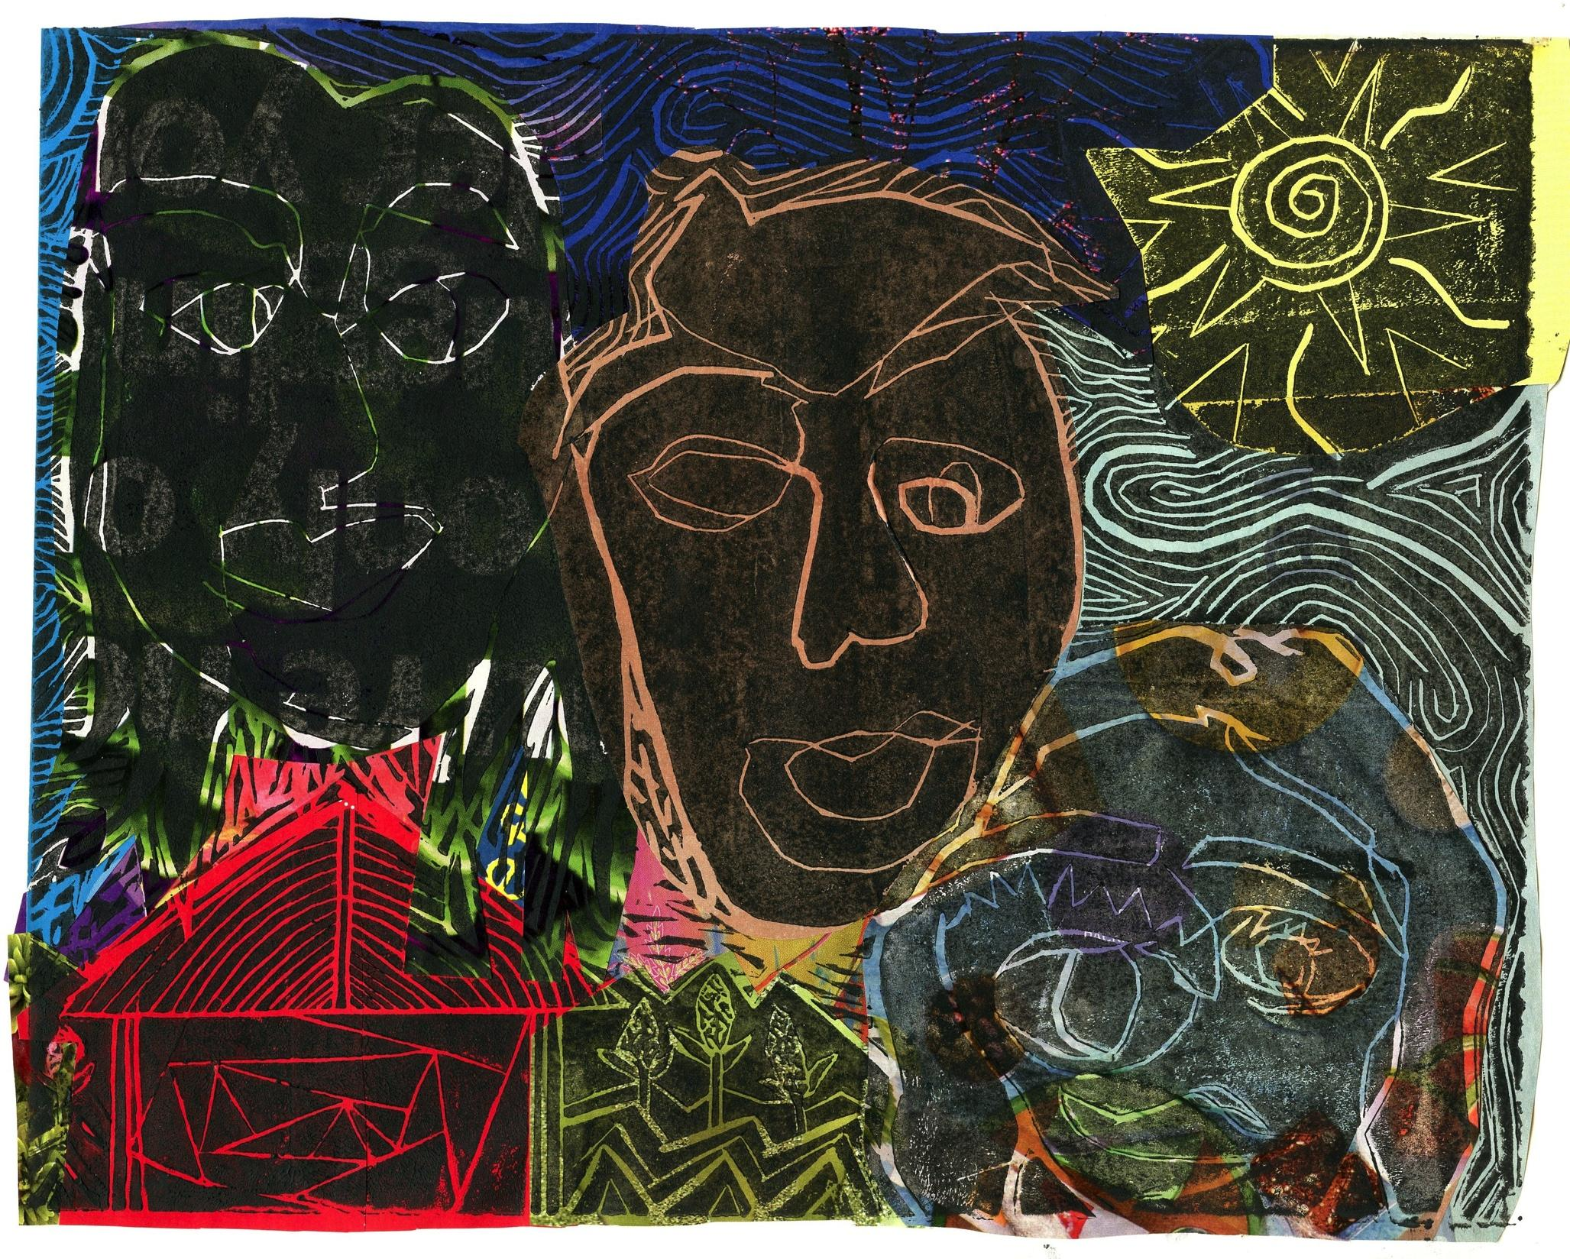
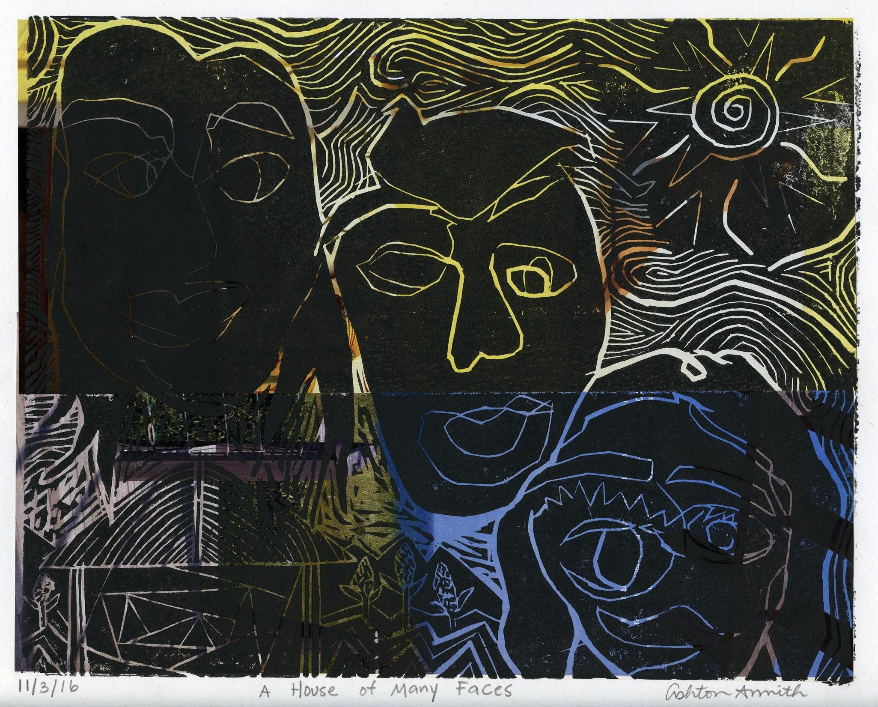
Chine-Colle
Notes:
7

Slide 8
My Message
A House of Many Faces
The message that I was attempting to accomplish was that people should live in peace and harmony with each other. I chose students from different grades within the school to represent how the high school should work together as a community. Also, by doing a blind contour of each face, the art shows that it does not matter how a person looks on the outside, but it is the inside that matters. The house in the bottom left corner demonstrates the coming together of people of different backgrounds.
Notes:
8

