Slide 1
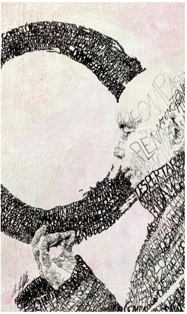
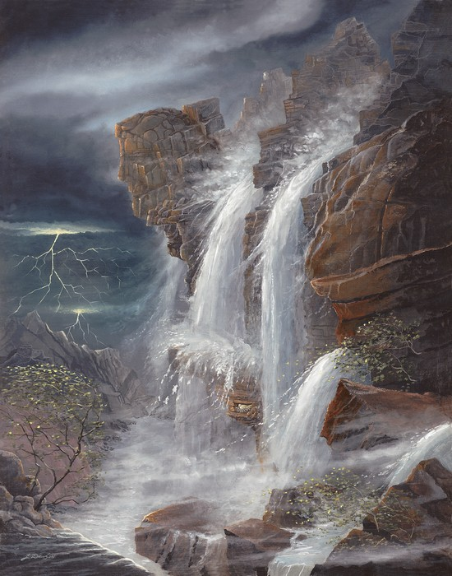
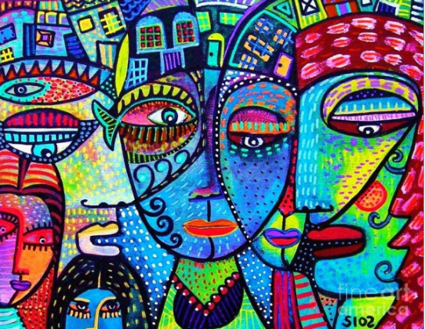
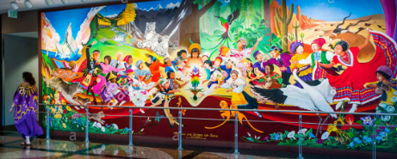
International Works of Peace
Ashton Smith

Slide 2
Thich Nhat Han
Michael Volpicelli
Oklahoma
This work is a portrait of Thich Nhat Han, a man who has undergone extreme hardship, yet one who was able to help create the peace movement during the Vietnam War.
I picked this work because it has a very different twist on what I think of when I think about peace. I also like that it literally tells a story.
http://www.ripleys.com/blog/inspiring-peace-icons/

Slide 3
“We have to walk in a way that we only print peace and serenity on the Earth. Walk as if you are kissing the Earth with your feet.”

Slide 4
Peace in Midst of the Storm
Jack E. Dawson
Arkansas
This painting is a scene of peace because it demonstrates the serenity that can be found, even when there is the fear of a huge storm.
I picked this work because it teaches us to find peace in every situation, even if life seems hopeless.
http://www.jackdawson.com/categories.php?category=Seek-%26-Find-Prints/Peace-in-the-Midst-of-the-Storm

Slide 5
“I have told you these things so that in me you may have peace. In this world, you will have trouble, but take heart! I have over come the world.” John16:33

Slide 6
In Peace and Harmony with Nature
Leo Tanguma
Colorado
This work demonstrates the harmony among all aspects of the world, the people, the animals, and nature. It shows a joyful feeling of peace on Earth.
I picked this work because it is so vibrant with the colors that the painter chose. Just looking at the picture makes me feel happy.
http://www.publicartarchive.org/work/peace-and-harmony-nature

Slide 7
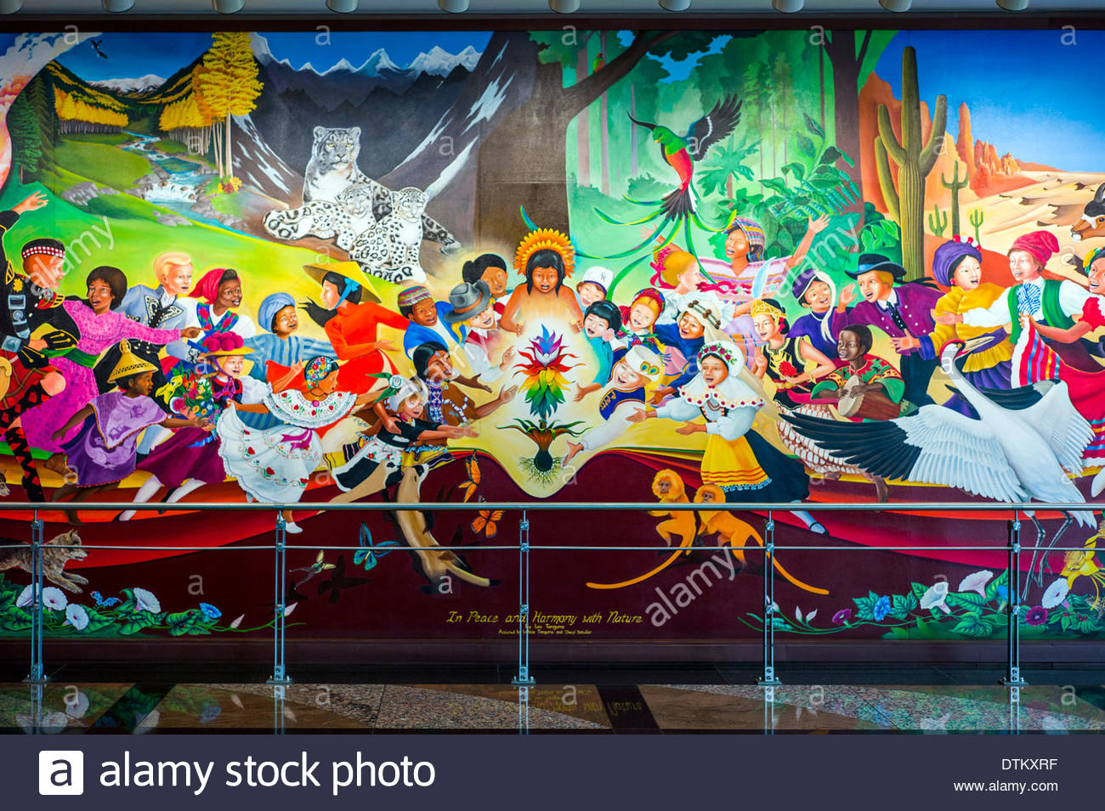
“My mission is to emphasize human dignity in all people, preserve the heritage of Chicanos, and most importantly, to stress the ideals of love, respect and justice.”

Slide 8
House of Love and Diversity
Sandra Silberzweig
Toronto
This painting represents the peace that can be found even in diversity. Although the faces and the houses are not all just alike, they work together to create one, harmonic piece.
I chose to work with this piece because the vibrant colors, and the modern twist that is placed on peace. I enjoy how the aspects of diversity are made into one.
http://7lameslamer.net/la-diversite-serait-elle-juste-une-1232.html

Slide 9
“I am a synethesia goddess’
I have no fear of color.
It lives in my soul, dances in my heart,
Spills out of my fingers flowing down a canvas.
I can see your aura,
Taste the color black,
Feel the chill of the green wind,
Smell blue butterflies,
Hear the yellow rain.
Life is never boring when inspiration is always around.”

Slide 10
Looking the Storm in the Eye
The sky shattered above,
Dooming all creatures of the earth.
Hiding in the cliff birth,
There was a dove.
The bird did not fear,
Peace filled her soul.
For nature knew its role,
To pass the storm in the near.
In “Peace in the Midst of a Storm,”
The dove peered up into the sky.
Looking the storm in the eye,
She sensed the Earth was her dorm.

