Slide 1
“Peace Thru Art”
Creating a Visual Arts Classroom
Centered Around Peace
Jodi Tomboulian and Dr. Alice Arnold, ED. D
Examples of Student Art Projects
Supporting and Developing Peace Concepts
Peacethruart.weebly.com

Slide 2
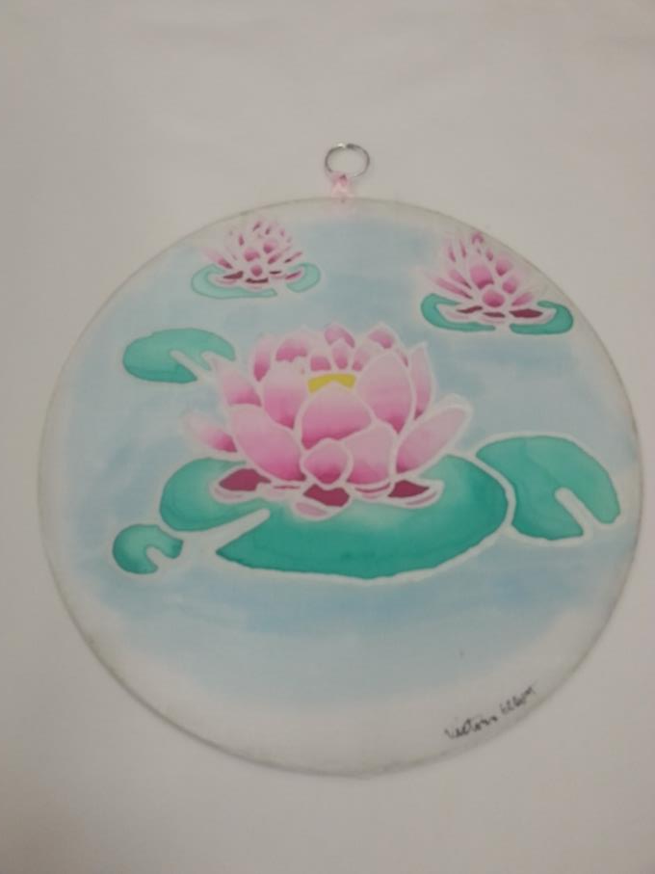
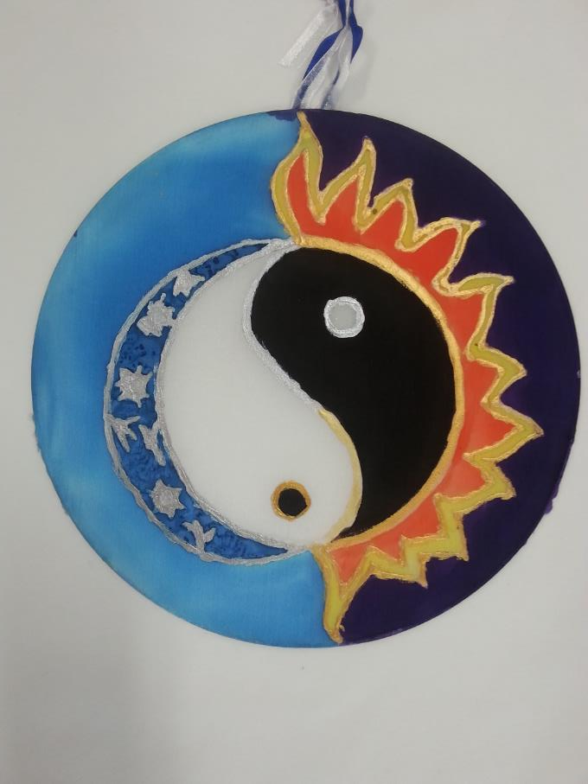
Wax resist and dye “Peace Hoops” displaying the students message of peace or what peace means to them.

Slide 3
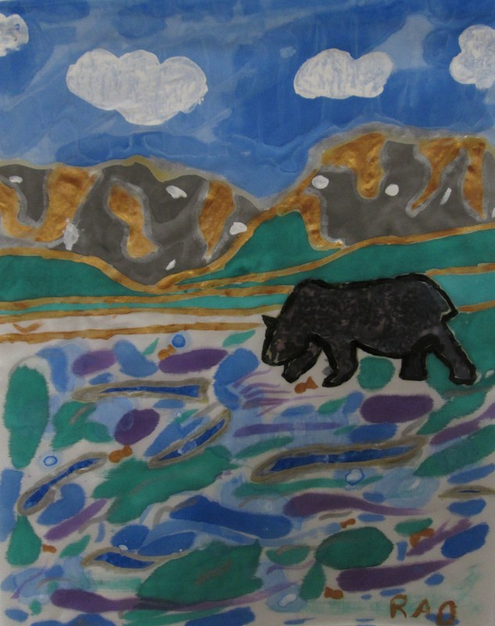
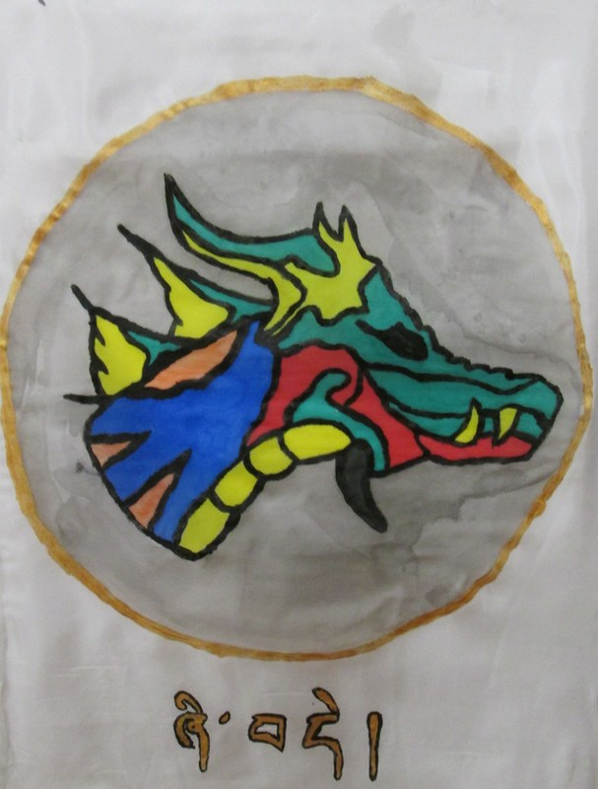
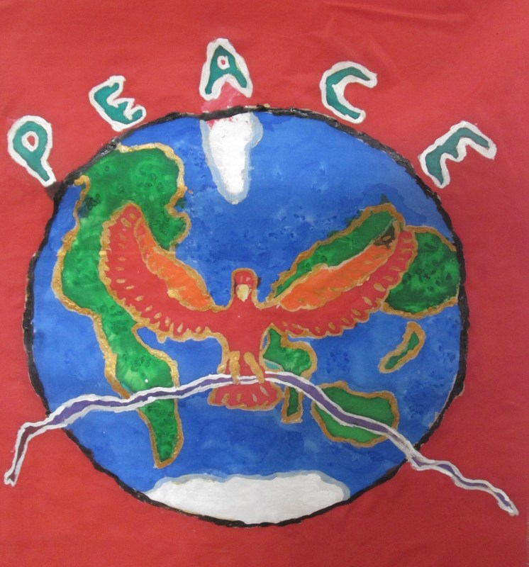
Peace flags: Inspired by the Tibetan prayer flags, students used wax resist and dye on silk to create their message of peace or their depiction of a peaceful place. The flags were strung displaying background colors in the same order as the prayer flags: Blue for space, white for air/wind, red for fire, green for water, and yellow for earth.

Slide 4
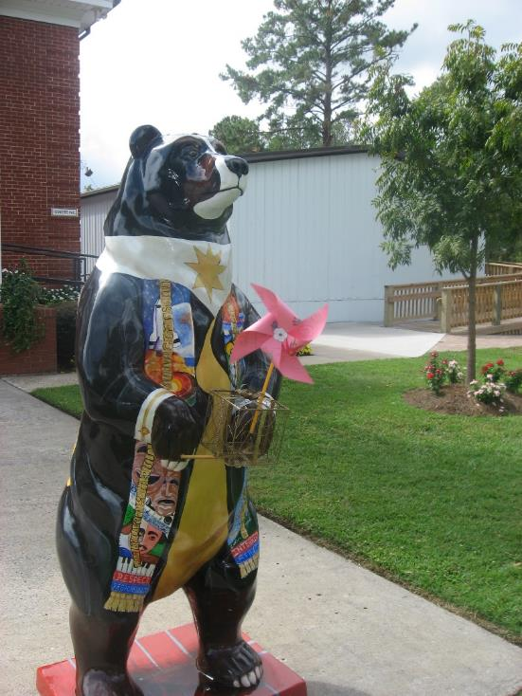
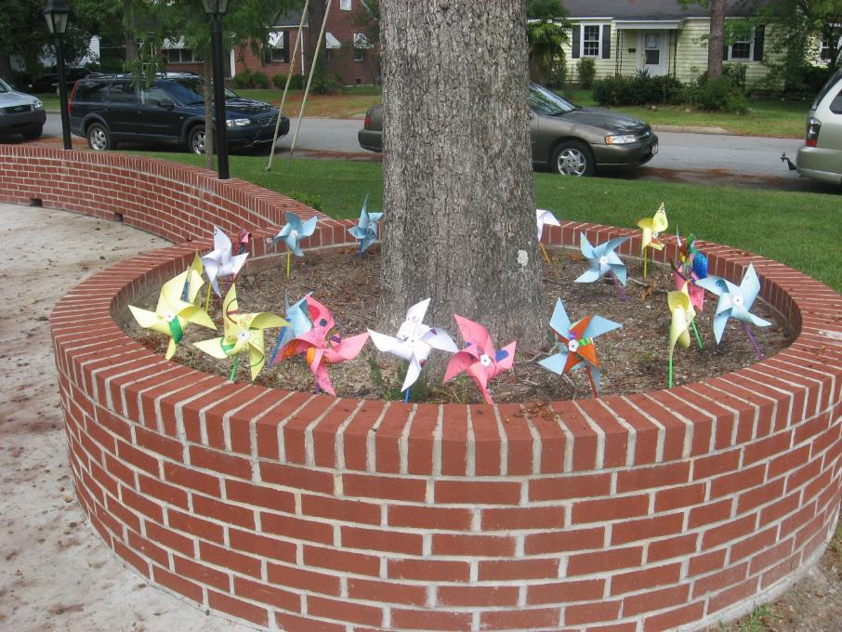
Pinwheels for Peace (Pinwheelsforpeace.com)

Slide 5
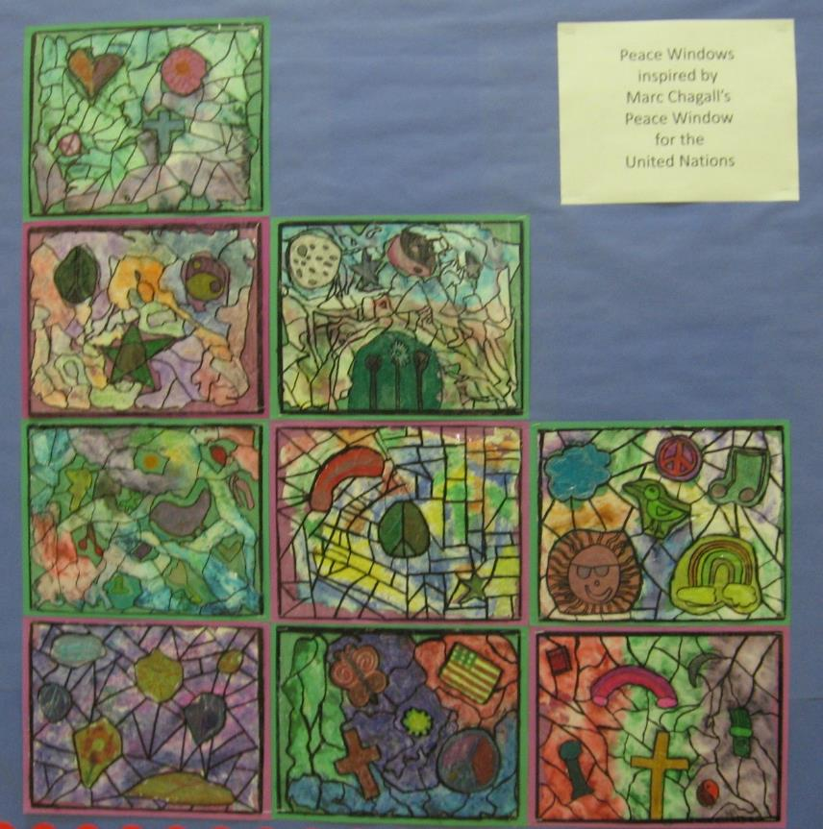
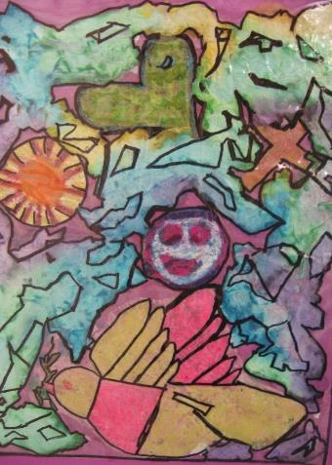
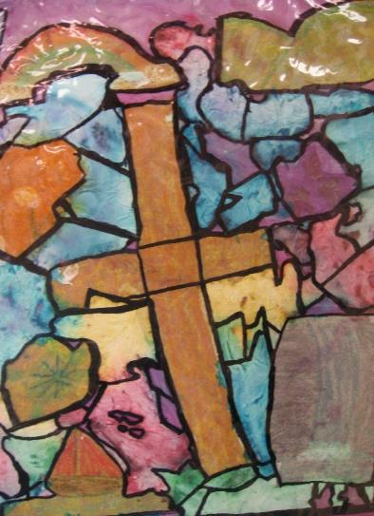
Peace Windows inspired by Marc Chagall’s Peace Windows for the United Nations (6th grade).
http://www.dickblick.com/lessonplans/peace-windows-in-the-style-of-marc-chagalls-stained-glass/

Slide 6
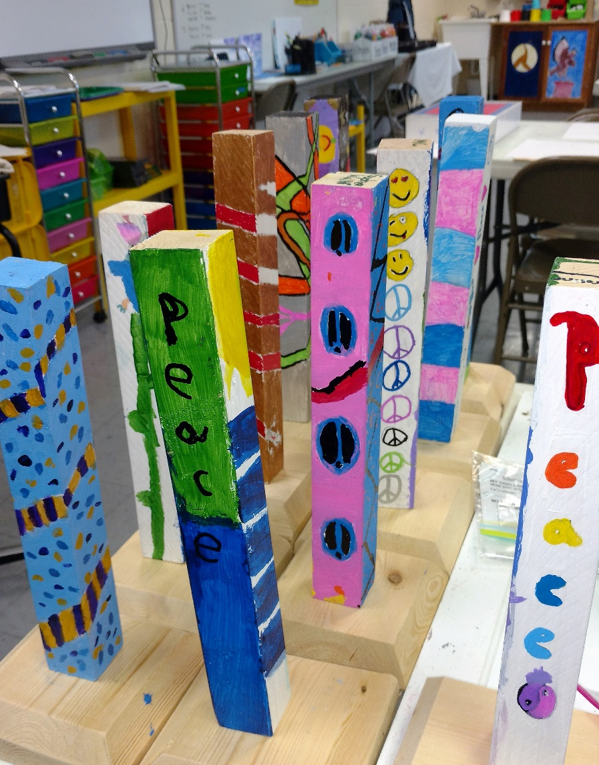
Peace Poles for School Community
The Epiphany School of Global Studies
Peace Pole:
“Lord, Grant Us Peace”
in eight languages.
The Peace Pole Project
is an international project that uses the phrase:
“May Peace Prevail On Earth.”
peacepoleproject.org

Slide 7
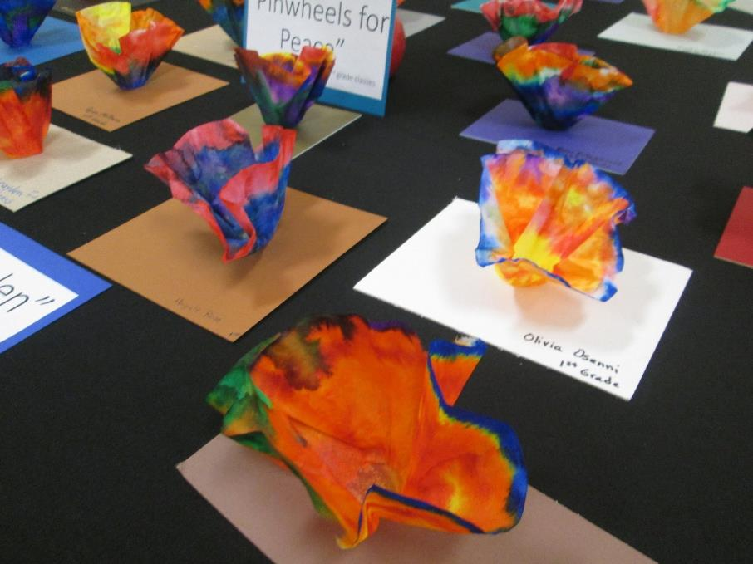
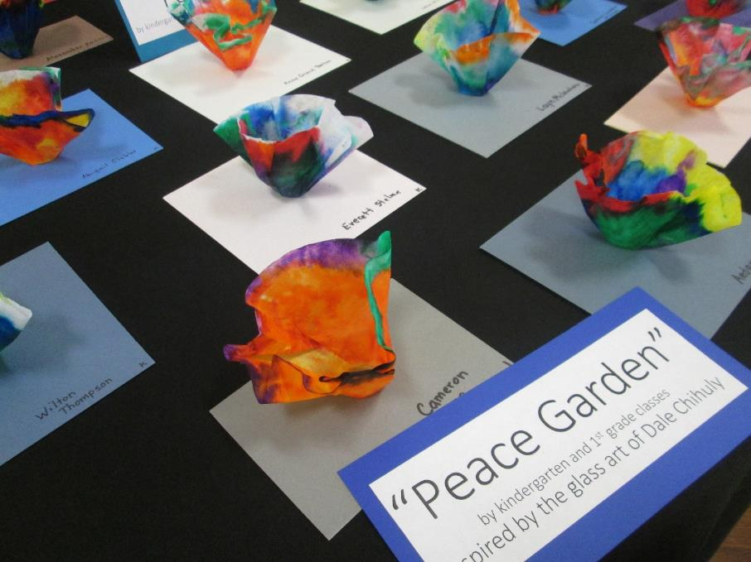
Kindergarten: “Peace Garden” inspired by Dale Chihuly’s blown glass flowers.

Slide 8
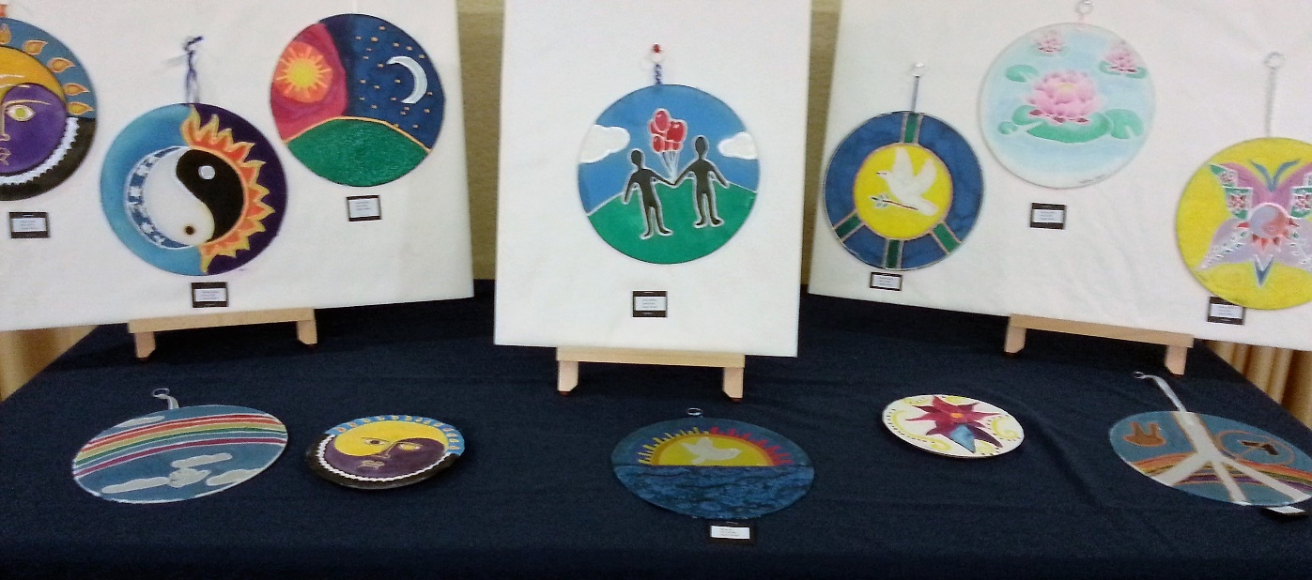
International Peace Day Displays

Slide 9
China and United States Exchange
Who: 1) Chinese Middle School EFL students
at the Luoyani Xingwen Middle School in
China
2) American Middle and Upper School Art Students
at The Epiphany School of Global Studies
What: Chinese EFL student writings on inner peace or a
description of a peaceful place and
American art students depiction of these writings
(罗娅妮)
Notes:
M

Slide 10
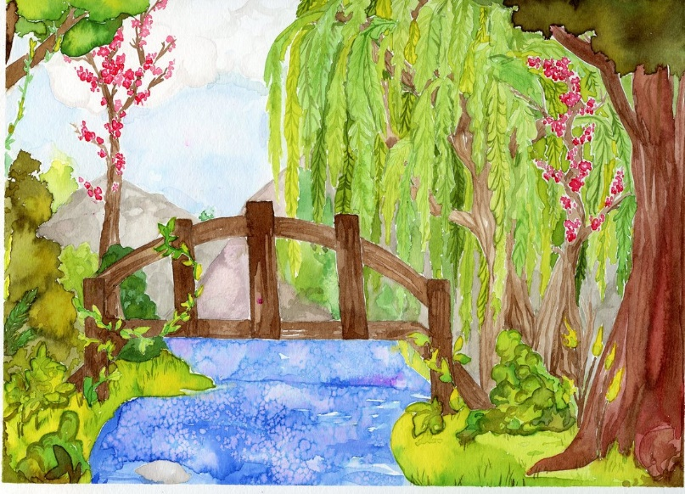
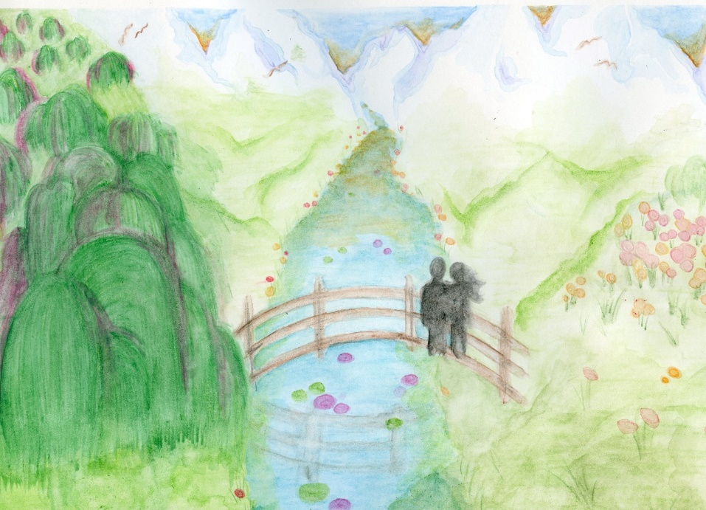
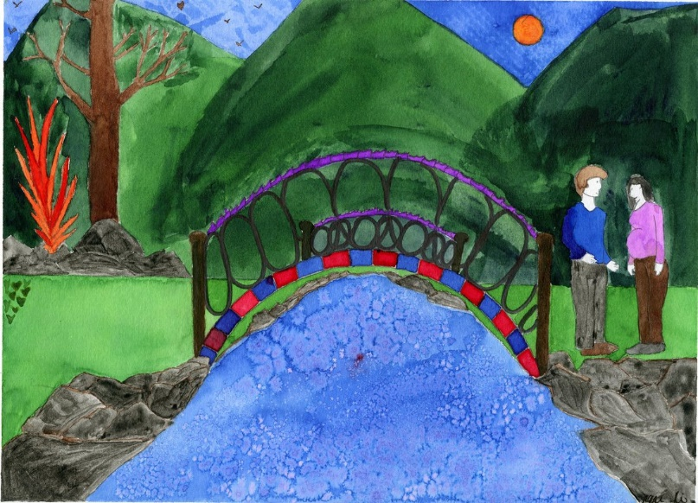
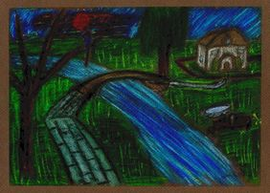
Art 1 and 2 Assignment: Illustrate one of the Chinese student’s writings (“A Small River” by Penglian or “A Charming Place” by Elsa) and write an artist's statement
Joy: 11th grade
Violet: 9th grade
Aiden: 10th grade

Slide 11
American Art Student’s Assignments
Art 2:
Create a triptych inspired by the poem,
“Whale, We,” written by a Chinese student
whose prompt was “Peace Within” 1. Literal meaning of the poem 2. The "deeper" more figurative meaning 3. Your own painting on "inner peace"

Slide 12
Whale , We
By Cu (Peace)
I have a dream I want to live under the water
There is my friend there, Anny Anny is a whale
Who lives alone Who is the same as me
While I am doing my work She is swimming over my head
We can't touch each other
But we can have eye contact That gives me inner peace
Sometimes ever Sometimes never
Whale, we Will we ?

Slide 13
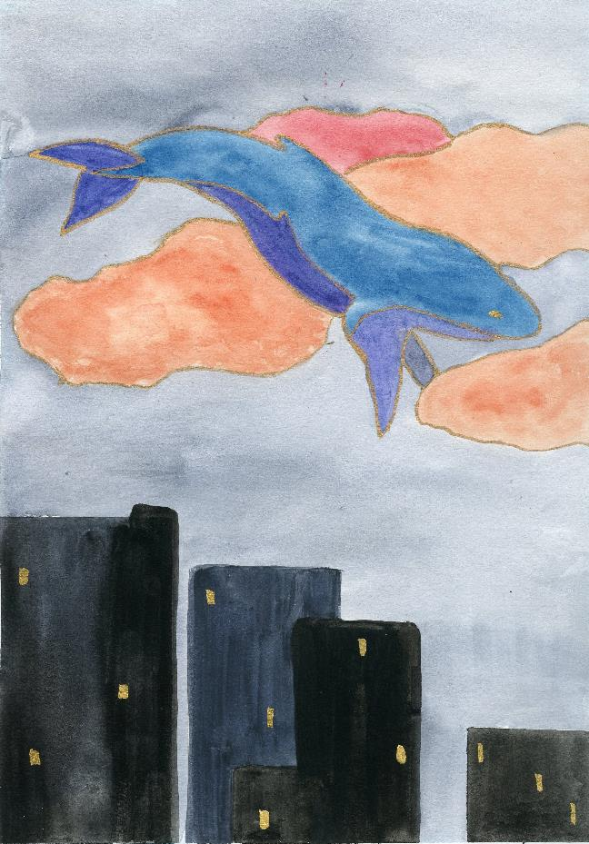
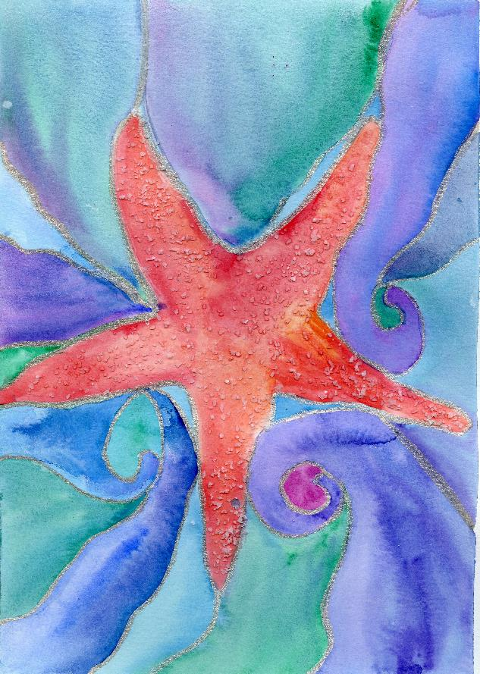
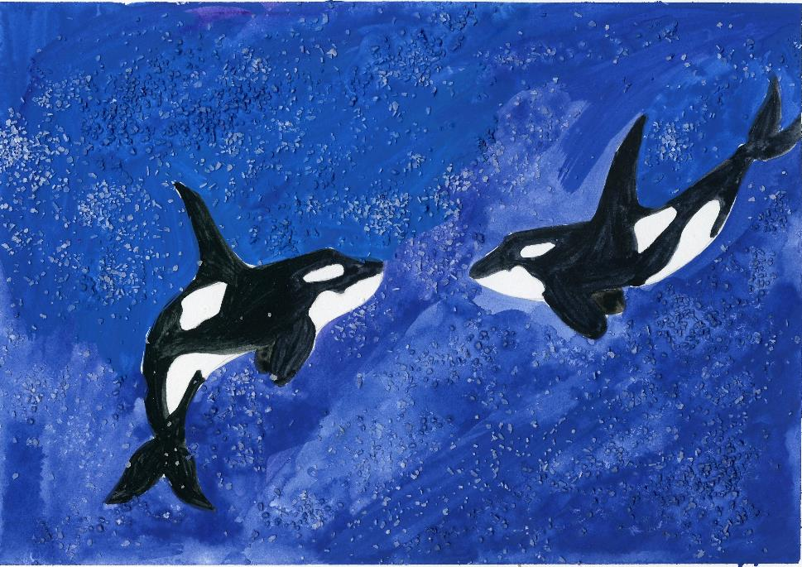
1.
3.
2.
By: Anna
Notes:
1. The first painting is the literal depiction of the poem. I used a darker background to emphasize the whale and the floating feeling in the clouds. The whale looks as if it is floating through coral and peach colored clouds. I made the whale float over the city the way that the whale floats through her thoughts in the poem in a peaceful state. It combines the idea of living under water but also the reality of the city landscape.
2. This the image I used to describe the deeper meaning of the poem. I used two whales looking into each other’s eyes almost as if they are separated by a glass wall. I used the distance in deep blue to portray the distance surrounding the question, “will we?”
3. The last watercolor painting is my own depiction of peace. Cool waters swirl around the warm starfish as if it were in a tide pool. I used salt on the starfish to add texture of the bumpy surface of a real starfish. This is peaceful to me because of the swirling motion that goes on around the starfish while the sea creature remains still.

Slide 14
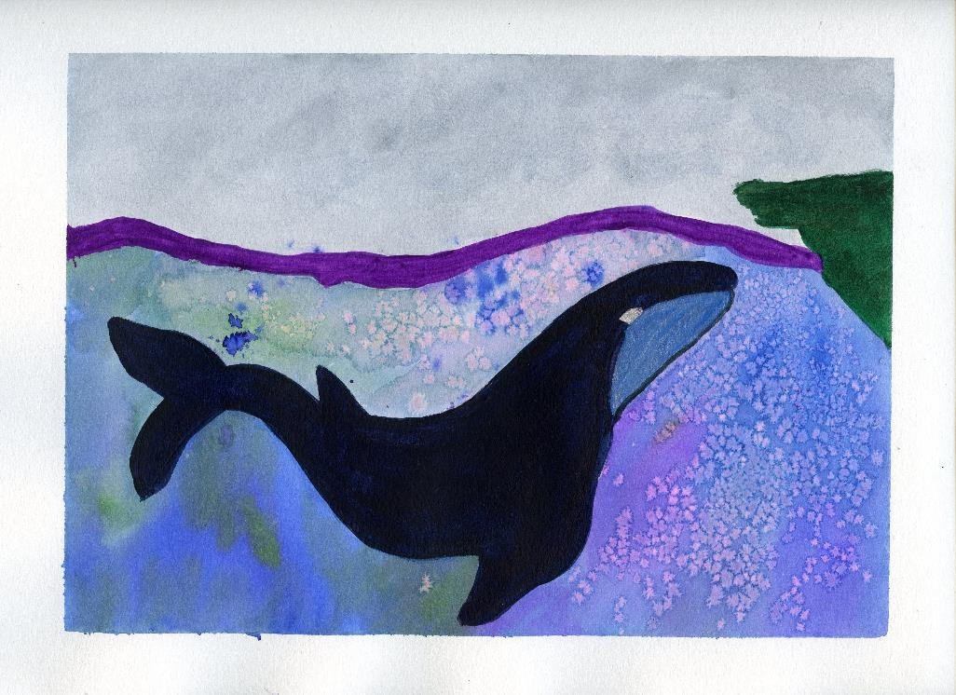
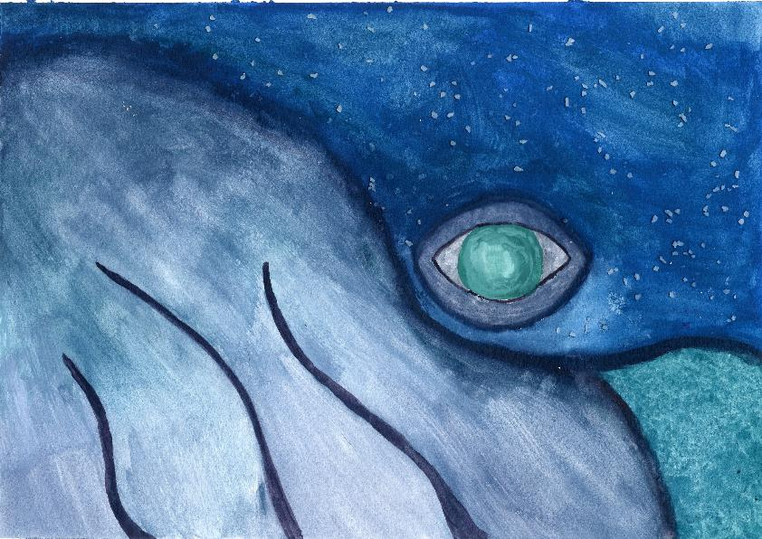
3.
1.
2.
By Ashton
Notes:
1. Literal Meaning: The whale in this painting is coming to shore to meet his friend. Although they live in different worlds, they can relate to each other, and they make each other not feel alone anymore. The whale comes from miles away each day to greet his friend on the shore. The friend is not shown in the painting, but the whale is positive that she will arrive shortly to do her work and they will sit together in peace.
2. Deeper Meaning: The close up of the whale’s eye, looking the viewer in the face, represents the peace that is held within the magnanimous creature. The eye is an inlet to the whale’s soul, and it is clear that as the whale floats across the sea, he is completely content with his life. The vast ocean that the whale lives in opens up endless opportunities and places to travel. However, the whale is the happiest when he is close to shore, and he knows that he will be able to see his friend each day and become something even bigger than himself.
3. My Peace Place: My place of peace is anywhere that I can watch the sunset over the water. I used warm colors in both the sea and the sky to symbolize the warmth that I feel in my soul when I am in a completely tranquil state. As the sun approaches the horizon, even the trees and the grass stop to watch the beauty that lies before them. All of the earth, especially myself, is awestruck by the glory and peace that comes with the setting sun.

Slide 15
Example of Upper School Thematic Unit: ​Project #1: Research three different international art works on peace. Create a short Powerpoint to share your findings with the class. Project #2: Choose one of these works and write an Ekphrasis poem about it. ​ Project #3: Create your own artwork on peace inspired by one of the international art works that you researched. Create a Powerpoint that including your artwork and its inspiration and your artist’s statement explaining how their connection and how they relate to the theme of peace.

Slide 16
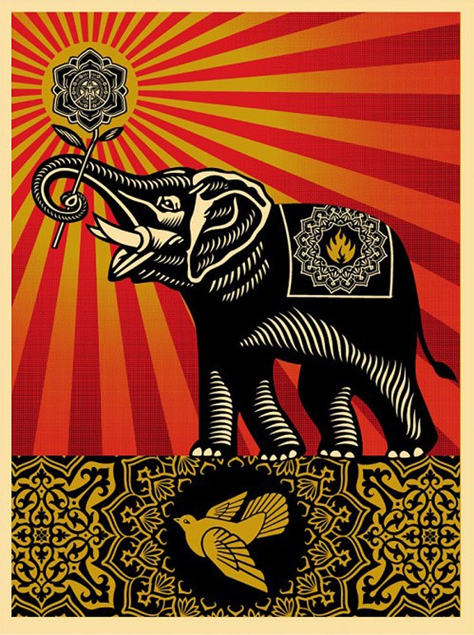
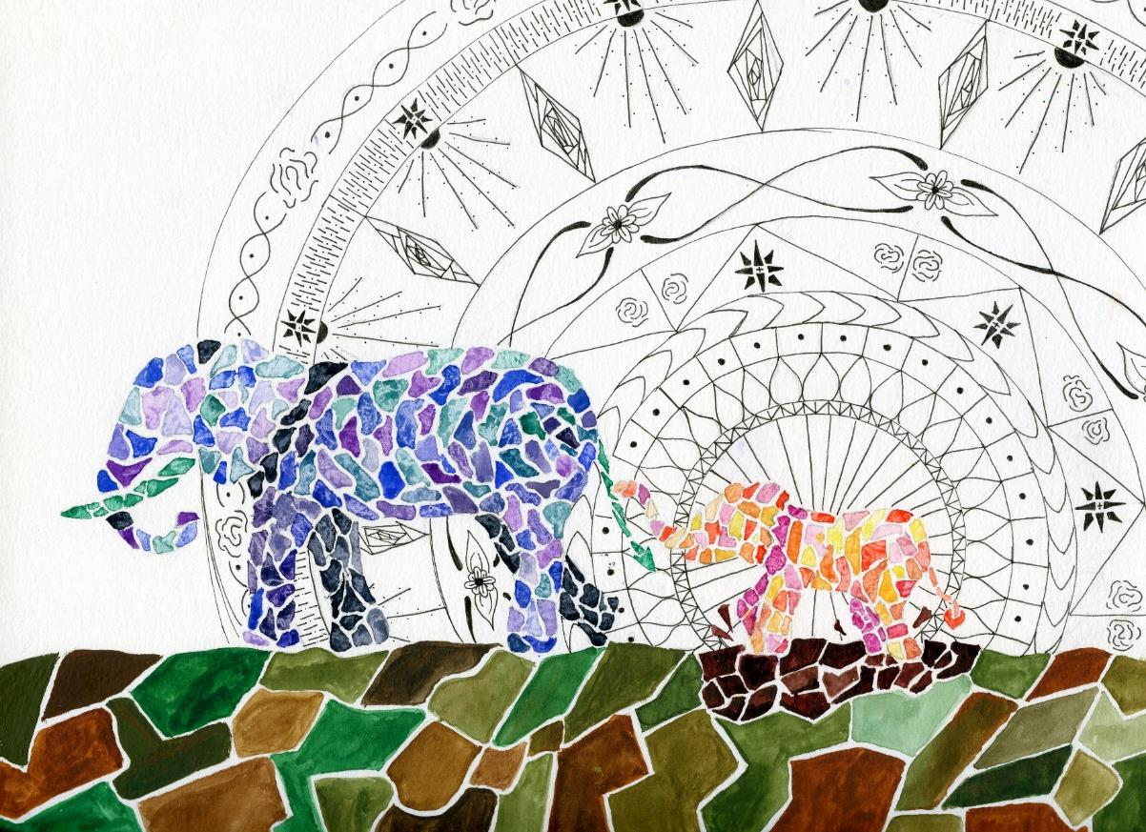
“Peace”
by California street artist
Shepard Fairey
https://www.wired.com/2010/08/shepard-fairey-auction
“NOONTIME WALK”
BY ANNA (12th Grade Student)
Notes:
“PEACE” This street artist is Los Angeles, California. All the colors are visually pleasing to the eye even though they contrast each other and may seem vivid. I like how he incorporates the usual signs of peace with a dove but also includes the elephant as well. This 2008 piece of graphic art inspired me through the unique representation of peace. While the dove is present which is known to represent peace, there is also an elephant. Elephants are known to be dangerous at times but in this situation, holding a flower, it is peaceful. The flower is also a mandala, a spiritual and religious symbol often used in artworks regarding peace.
Noontime Walk: I used water color to paint the two elephants and the ground in a geometric pattern. Behind the smaller, younger elephant is a mandala drawn in fine tip black pen. I wanted to convey that there are multiple types of peace. There is the older, mature peace represented in the cooler darker colors of the mother elephant that comes with age and experience. There is also the unrestrained peace of the elephant splashing in the mud shown through bright colors. This peace comes from the knowledge that, just as the baby as his trunk wrapped around his mother’s tail, we all have something we can rely on. The mandala shows that peace starts even at an early age as it bursts out from the baby elephant like rays from the sun.
Message of Peace: Both Fairey’s and my own elephants convey peace alongside a mandala. Fairey’s shows peace as the elephant takes a dominant stance, ready to stand firm in the name of peace. My elephants, however, walk along knowing they are in a time of peace. Both show that peace is not just freedom from war, but a state of mind or a desire to fulfill.

Slide 17
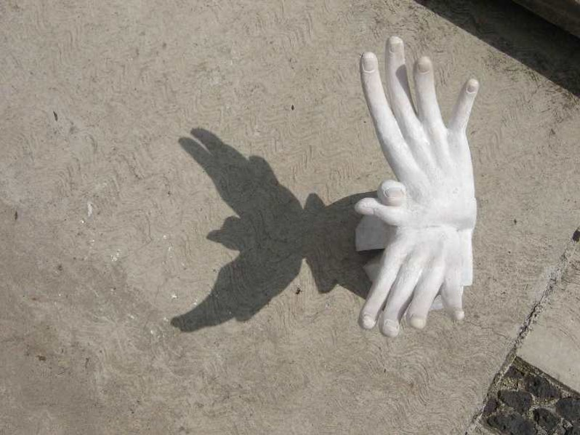
Peace: Ekphrasis poem
Ekphrasis poem
Hidden Peace ​by Anna Clasped together by a thumb; Intertwined. Not to be undone, By the test of time. Though they might seem like just hands, If you take another view, Another stand. A dove will rise anew.
Peace In Our Hands by Glenda Hecksher
http://cpnn-world.org/cgi-bin/read/articlepage.cgi?ViewArticle=353

Slide 18
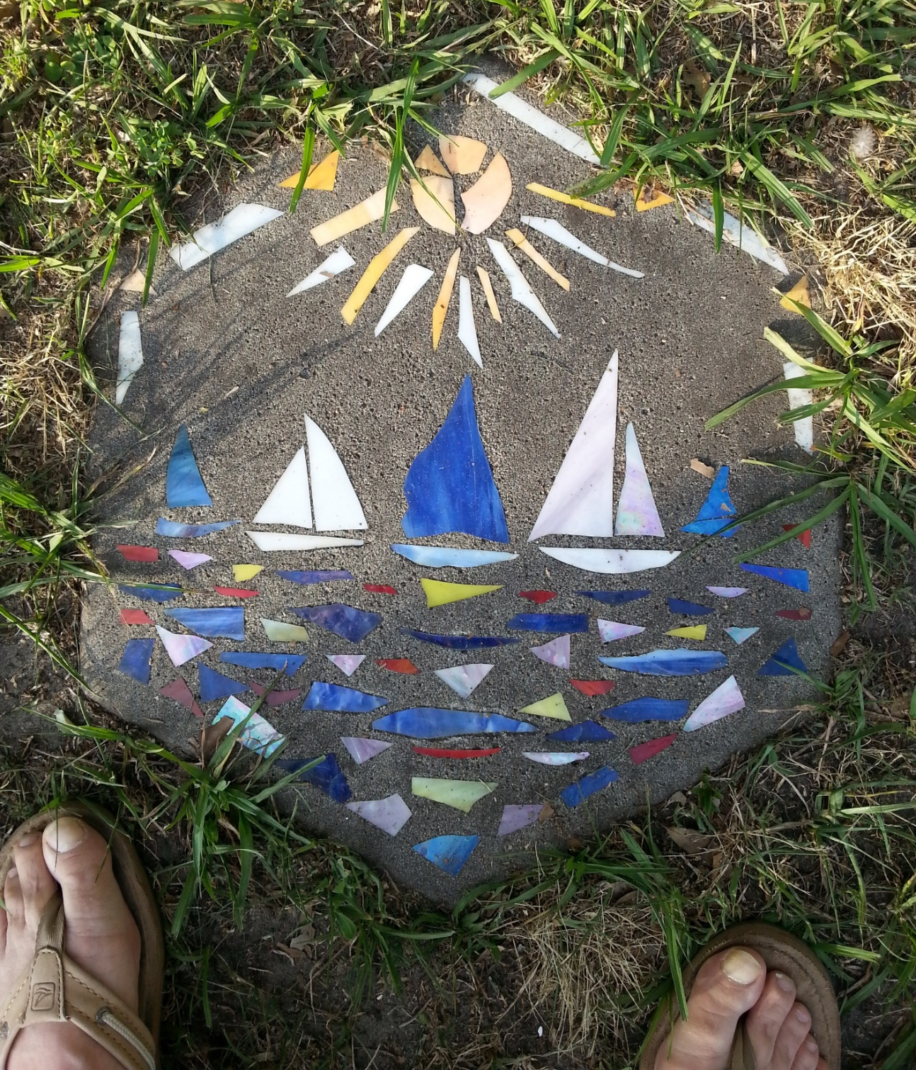
“Peace Thru Art”
For more examples visit
Peacethruart.weebly.com

Slide 19
References
Anderson, T. (2009). The kids' Guernica peace mural project: A paradigm for global
art education. In E. M. Delacruz (Ed.), Globalization Art & Education
(pp. 231-237). Reston, VA, USA: National Art Education Association.
Anonimo. (2013, January 14). Johann Heinrich Pestalozzi—Father of Modern
Education. Retrieved Feb. 11, 2017, from Modern Education: http://mode
ducation.blogspot.com/2013/01/johann-heinrich-pestalozzifather-of.html
Ayers, M. &. (2015). The pinwheels for peace project. Retrieved March 9, 2016, from
http://www.pinwheelsforpeace.com/pinwheelsforpeace/the_project.html
Derstine, R. T. (1993). Where Is Peace Born. In K. Aschliman (Ed.), Growing Toward
Peace. Scottdale: Herald Press.
Jackson, V. B. (n.d.). Educating for Global Competence: Preparing Our Youth to
Engage the World. Council of Chief State School Officers’ EdSteps Initiative &
Asia Society Partnership for Global Learning. Retrieved from
https://asiasociety.org/files/book-globalcompetence.pdf

