Slide 1
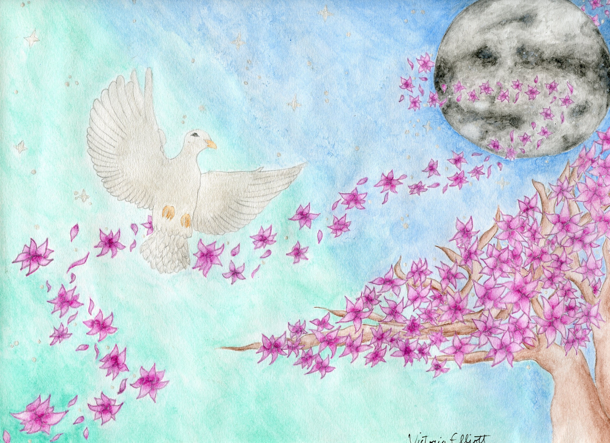
Independent Peace Project
“Peace In Simplicity”
By Victoria

Slide 2
Method
Watercolor pencils
Drew the whole thing in pencil
Began by coloring in a few things at a time and then using water to blend the colors cohesively.
I drew the “craters” on the moon then colored it in lightly with gray, then even darker with the gray, and then added black in some places.
I used pearly white acrylic paint for the dove

Slide 3
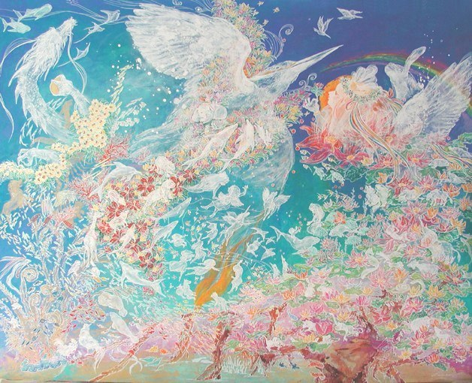
“Love Wind”
Kondo Chihiro
It’s very whimsical, different, light-hearted, yet quite busy.
The contrast of the background emphasizes the light in the painting and creates a tranquil, creative atmosphere.
I like to think of it as beautiful chaos.

Slide 4
I took the complexity of the other work and simplified it. The appearances of each work are noticeably similar but each work is unique and illustrates that peace can be achieved through different means. My inspiration conveys that peace can be chaotic and beautiful simultaneously, and my work, on the other hand, illustrates that peace doesn’t necessarily have to stem from chaos.
What They Mean

