Slide 1
International Artworks of Peace
By Victoria

Slide 2
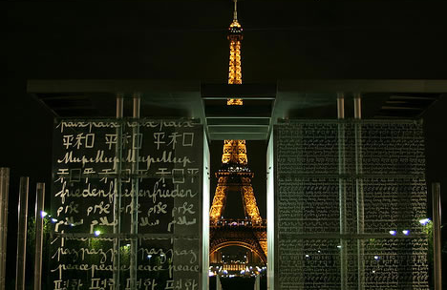
Wall of Peace
Located in Paris, France
Designed by Clara Halter and built by architect Jean-Michel Wilmotte
“Peace” is written in 32 languages and 18 different alphabet
Everyone, no matter where they’re from, will understand the message of international peace.
http://weburbanist.com/2008/05/16/12-compelling-monuments-dedicated-to-peace-reversing-the-typology-of-the-war-memorial/

Slide 3
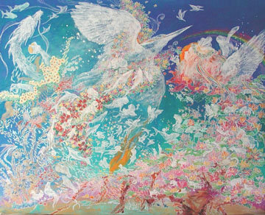
“Love Wind”
Located in the Chelsea Art Museum in New York City, NY
Painted by Chihiro Kondo
A dove, which is a historical symbol of peace, is the central focus
The light and almost airy feeling of this painting is tranquil yet inspiring and doesn’t depict anything that opposes peace
http://harmonyforpeace.org/content/international-peace-art-exhibit

Slide 4
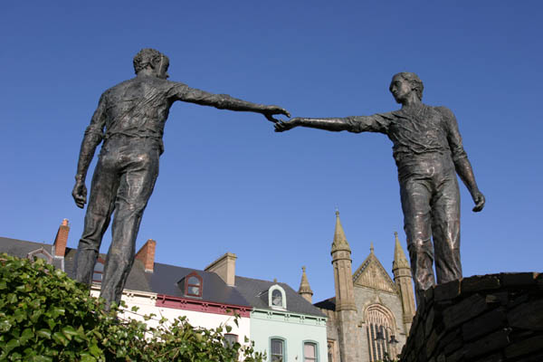
“Hands Across the Divide”
It is located at the end of Craigavon Bridge in Derry, Northern Ireland
Created by Maurice Harron
Derry has a river running through it that separates the city so this piece of art symbolizes a sense of unity and peace between both sides despite their differences
http://www.derryjournal.com/whats-on/derry-s-iconic-hands-are-finally-united-1-4819204

Slide 5
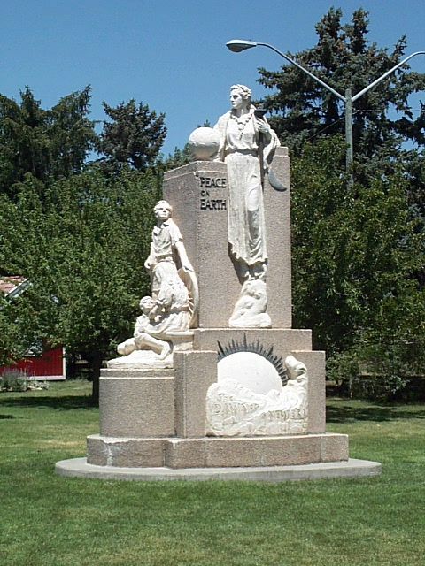
“Peace on Earth”
Located in Salt Lake City, Utah
Initiated in 1940 by the Salt Lake Council of Women
It is symbolic of the hope that we can leave a more peaceful future for our children because in order to keep the world a peaceful place, generations to come need to continue valuing morals of peace and kindness
http://peace.maripo.com/p_statues.htm

